Slide 1

Formalism and Platform for Autonomous Distributed Components
BioNets project - Ludovic Henrio
Bio-inspired Networks and Services
A Distributed Component Model
Formalisation in Isabelle
Autonomous components:
Componentise component management and distributed reconfiguration
FMCO 2009

Slide 2
Autonomicity in Communication systems
Autonomic composition
Structured programming
Autonomicity in Distributed Components
Autonomic Composition of Services in the context of autonomic communications:
  Discovery space fully open,
  Runtime support only locally on the device
Which software component model:
  structured, hierarchical, and distributed
  Strong encapsulation, raising the level of abstraction
  clear separation between functional and non-functional concerns
  strong support for autonomic programming
We chose the Grid Component Model

Slide 3
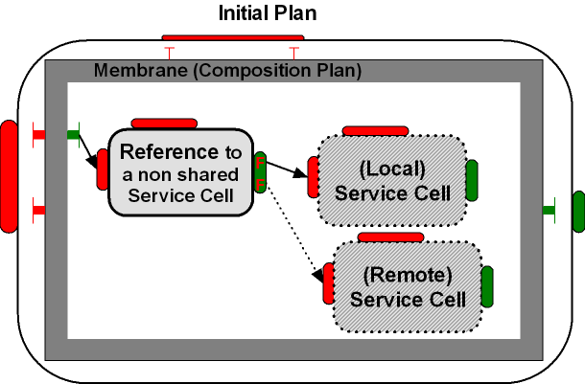
BIONETS Service Discovery, Execution, Evaluation, Evolution, Depreciation
ReQuest
ReQuest
Global behaviour:
comes from the large
number of mobile devices
(statistical behavior)
ReQuest
ReQuest
ReQuest
ReQuest
ReQuest
Reply
Bio-inspired (genetic, chemical computing) evolution
But also socio-economic model,
evolutionary multi-players game theory, swarm intelligence

Slide 4
BIONETS Service Discovery, Execution, Evaluation, Evolution, Depreciation
ReQuest
ReQuest
Global behaviour:
comes from the large
number of mobile devices
(statistical behavior)
ReQuest
Reply
ReQuest
ReQuest
Reply
ReQuest
ReQuest
Reply
ReQuest
Reply
Bio-inspired (genetic, chemical computing) evolution
But also socio-economic model,
evolutionary multi-players game theory, swarm intelligence

Slide 5

BIONETS Service Discovery, Execution, Evaluation, Evolution, Depreciation
ReQuest
Global behaviour:
comes from the large
number of mobile devices
(statistical behavior)
ReQuest
Reply
ReQuest
ReQuest
Reply
ReQuest
ReQuest
ReQuest
Reply
ReQuest
Reply
Repl
Fitness
Reward
mark
Bio-inspired (genetic, chemical computing) evolution
But also socio-economic model,
evolutionary multi-players game theory, swarm intelligence

Slide 6
A DISTRIBUTED COMPONENT MODEL

Slide 7
What are (GCM) Components?
Bindings
NF (server) interfaces
Composite component
Client
interfaces
Server
interfaces
Primitive component
Business code
Primitive component
Business code
NB: interface = port

Slide 8
A Primitive GCM Component
CI
CI.foo(p)
Primitive components communicating by asynchronous remote method invocations on interfaces (requests)
Components abstract away distribution and concurrency
in ProActive components are mono-threaded
➔ simplifies concurrency but can create deadlocks

Slide 9
Composition in GCM
Bindings:
Requests = Asynchronous method invocations

Slide 10
Futures for Components
f=CI.foo(p)
……….
f.bar()
f.bar()
Component are independent entities
(threads are isolated in a component)
+
Asynchronous method invocations with results
⬇
Futures are necessary

Slide 11
Replies
…
…
…
f=CI.foo(p)
f.bar()

Slide 12
Approach: a refined GCM model
A model:
  more precise than GCM, give a semantics to the model:
    future / requests
    request queues
    no shared memory between components
    notion of request service
  less precise than ProActive/GCM
    can be multithreaded
    no “active object” model

Slide 13
FORMALISATION

Slide 14
Objectives
A model general enough to study GCM, but also other component models interacting by requests
In a theorem prover (Isabelle)
To study
  the GCM component model,
  its implementation(s),
  interaction between futures and components,
  component reconfiguration and management

Slide 15
Principles
component architecture:
  bindings
  interfaces (only functional)
  component composition
communications by requests and futures
  request queues
  future references
abstraction of the business code by a behaviour (~LTS)
values abstracted away: we just keep track of future references

Slide 16
Primitive Components
Primitive components are defined by interfaces plus an internal behaviour, they can:
  emit requests
  serve requests
  send results
  receive results (at any time)
  do internal actions
  some rules define a
  correct behaviour,
  e.g. one can only send result for a served request
We define the behaviour of the whole components as small-step operational semantics

Slide 17
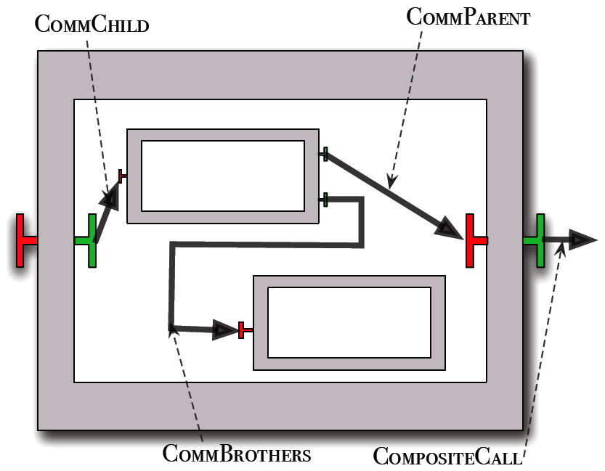
Composite Components
Composite components are defined by their interfaces + content + bindings
Semantics
  Composites also have request queues (futures)
  Only delegate calls to inner or outer components
  Use the bindings to know
  where to transmit requests
  Plus receive futures
  (like primitives)

Slide 18
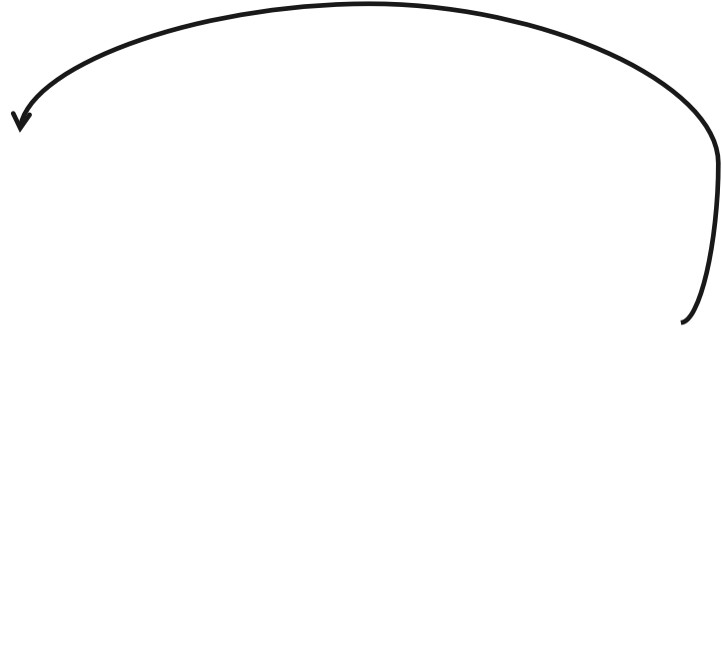
Future Update Strategies
How to bring future values to components that need them
Different strategies can be envisioned
A “naive” approach: Any component can receive a value for a future reference it holds. Not much operational.
More operational is the lazy approach:
require future value

Slide 19
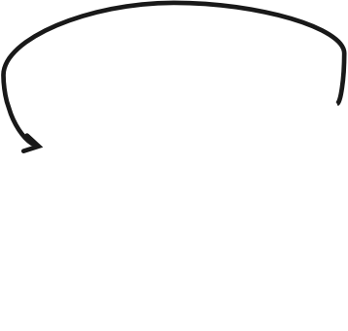
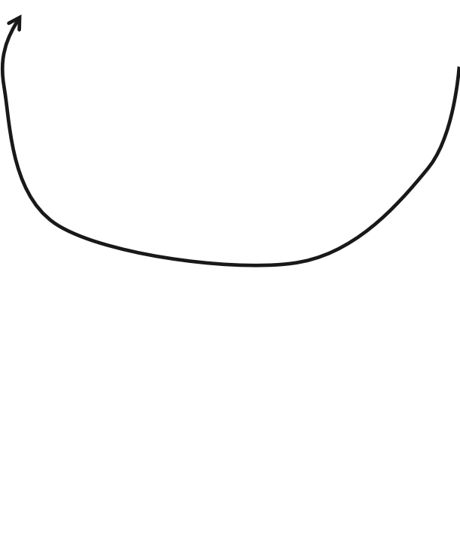
Eager home future update
A strategy avoiding to store future values indefinitely
Relies on future registration and sends the value as soon as it is calculated
register future
register future

Slide 20

First Proofs (ongoing)
Future update remove all references to a given future
All Future references are registered during reduction
A formalisation in Isabelle of Component structure + request / futures
Middle-term goal: correctness of various strategies

Slide 21
A PLATFORM FOR AUTONOMOUS COMPONENTS

Slide 22
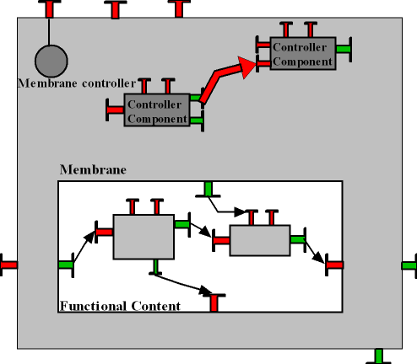
Non-functional Component Structure
Non-functional aspects as a composition of components (inside a membrane)
  A component structure for the membrane
  New kind of interfaces and bindings
  An API for reconfiguring
  the membrane
  Non-functional code is
    components or objects
    distributed or not

Slide 23
Adaptation in the GCM
Functional adaptation: adapt the architecture
+ behaviour of the application to new requirements/objectives
  add a new functionality
Non-functional adaptation: adapt the architecture of the container+middleware to changing environment/NF requirements (QoS …)
  Change communication protocol
  Update security policy
  …
Both functional and non-functional adaptation are expressed as reconfigurations

Slide 24
How to express reconfigurations?
We start from FScript:
A Scripting reconfiguration language
Dedicated to Fractal components
FPath expressions: navigate and select elements in the components architecture
Centralized execution

Slide 25
A Controller for Reconfigurations
Manages and allows the invocation of the script interpreter
Is collocated with the component
Exposes methods for reconfiguration
  setInterpreter(interpreterClassName)
  loadScript(scriptFileName)
  executeAction(actionName, arguments...)
Reconfiguration interface
Interpreter
Membrane

Slide 26
Triggering Distributed Reconfigurations in the Scripting Language
A primitive for the distributed script interpretation
  Triggers the action action_name by the interpreter located in target_component
  Receives action arguments as parameter
remote_call(target_component, action_name, parameters, ...);
Reconfiguration interface
action(arguments)
Interpreter
target_component

Slide 27
Example
Reconfiguration interface
definition action1
...
remote_call(C2,’action2’)
remote_call(C11,’action11’)
remote_call(C12,’action12’)
...
RC 2
Reconfiguration scripts
C2
definition action12
...
remote_call(C121,’action121’)
...
RC 1
Interpreter
Membrane
RC 11
RC 12
C11
RC 121

Slide 28
Example
Reconfiguration interface
definition action1
...
remote_call(C2,’action2’)
remote_call(C11,’action11’)
remote_call(C12,’action12’)
...
RC 2
Reconfiguration scripts
C2
action1( )
definition action12
...
remote_call(C121,’action121’)
...
RC 1
Interpreter
Membrane
RC 11
RC 12
C11
RC 121
C121
C12

Slide 29
Example
Reconfiguration interface
definition action1
...
remote_call(C2,’action2’)
remote_call(C11,’action11’)
remote_call(C12,’action12’)
...
RC 2
Reconfiguration scripts
C2
action1( )
action2( )
definition action12
...
remote_call(C121,’action121’)
...
RC 1
Interpreter
Membrane
action11( )
action12( )
RC 11
RC 12
C11
RC 121
C121
C12
C1

Slide 30
Example
Reconfiguration interface
definition action1
...
remote_call(C2,’action2’)
remote_call(C11,’action11’)
remote_call(C12,’action12’)
...
RC 2
Reconfiguration scripts
C2
action1( )
action2( )
definition action12
...
remote_call(C121,’action121’)
...
RC 1
Interpreter
Membrane
action11( )
action12( )
RC 11
RC 12
C11
action121( )
RC 121
C121
C12
C1

Slide 31
Example
Reconfiguration interface
definition action1
...
remote_call(C2,’action2’)
remote_call(C11,’action11’)
remote_call(C12,’action12’)
...
RC 2
Reconfiguration scripts
C2
action1( )
action2( )
definition action12
...
remote_call(C121,’action121’)
...
RC 1
Interpreter
Membrane
action11( )
action12( )
RC 11
RC 12
C11
action121( )
RC 121
The interpretation is parallel and distributed
C121
C12

Slide 32
Conclusion
A component model for adaptive autonomous components
  structured membrane
  distributed reconfiguration
A platform supporting adaptation and distribution
  based on ProActive (active objects, distribution)
  ADL (membrane and business code composition)
A formalisation to study the component model and its implementation
  toward verification of component management procedures

Slide 33
Ongoing and Future Works
Formalisation is a long process:
  For the moment, more a formal specification + a few proofs than a complete verification environment
Verification of (re)configuration procedures by model checking
  Complementary with Theorem proving approach application specific vs. model properties
  Already model generation relies on ASP properties

Slide 35
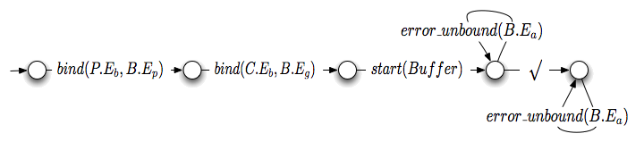
Verification of Properties: Deployment
start Buffer without linking the alarm interface
  The deployment is always successful
  [ (not √ )* ] < true * .√ > true
  But Error during deployment
  [ (not √ ) * . O_{E} ] false

Slide 36
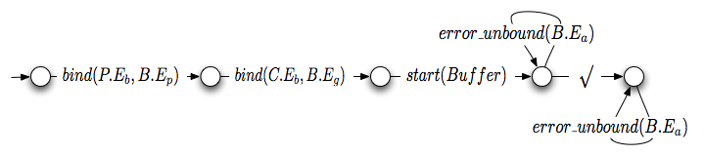
Verification of Properties regular μ-calculus (Mateescu’2004)
Deployment
(on the Static Automaton with successful synchronisation visible)
  The deployment is always successful
  [ (not √ )* ] < true * .√ > true
  No Error during deployment
  [ (not √ ) * . O_{E} ] false
e.g. start Buffer without linking the alarm interface
Eric MADELAINE ---- OASIS

Slide 37


Verification of Properties
Functional properties under reconfiguration (respecting the topology)
  Future update (asynchronous result messages) independent of life-cycle or binding reconfigurations
  Build a model including life-cycle controllers,
    with the reconfiguration actions visible:
  Then we can prove:
[ true*.Req_Get() ] μX. (< true > true ∧ [¬Resp_Get() ] X )
Eric MADELAINE ---- OASIS
Notes:
Parler op de reconfig avant

Slide 38
Example
Add the component given_child to the composite given_parent
given_parent
given_parent
given_child
remote_call($given_parent, ‘add’, ‘$given_parent’, ‘given_child’);

Slide 39
GCM API for Reconfiguration
Life-cycle controller
Binding controller
Content Controller
string getFcState ();
void startFc () throws IllegalLifeCycleException;
void stopFc () throws IllegalLifeCycleException;
string[] listFc ();
any lookupFc (string clientItfName)
throws NoSuchInterfaceException;
void bindFc (string clientItfName, any serverItf) throws . . .
void unbindFc (string clientItfName) throws. . .
any[] getFcInternalInterfaces ();
any getFcInternalInterface (string itfName) throws . . . Component[] getFcSubComponents ();
void addFcSubComponent (Component c) throws . . .
void removeFcSubComponent (Component c) throws . . .

